Slide 1
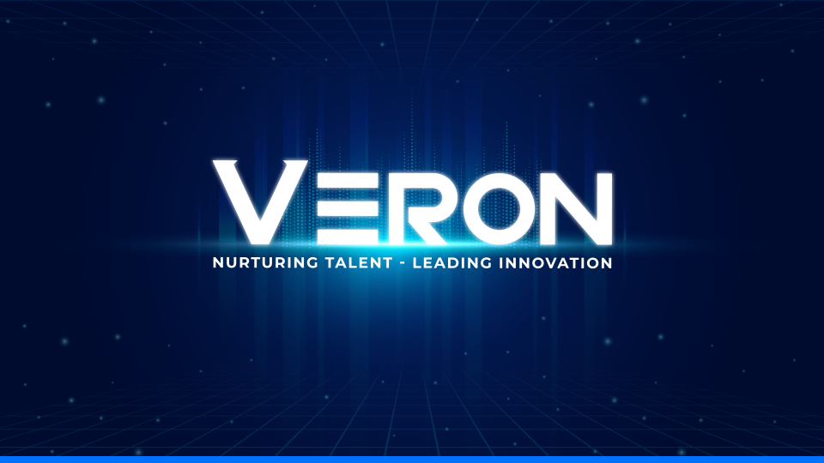

Slide 2

DPU - AI Agent Box
Version 0.1

Slide 3

Agenda
Overview
Introduction
Process
Protection and Licensing
Technology and Tools
Timeline
Risk management
Conclusion

Slide 4

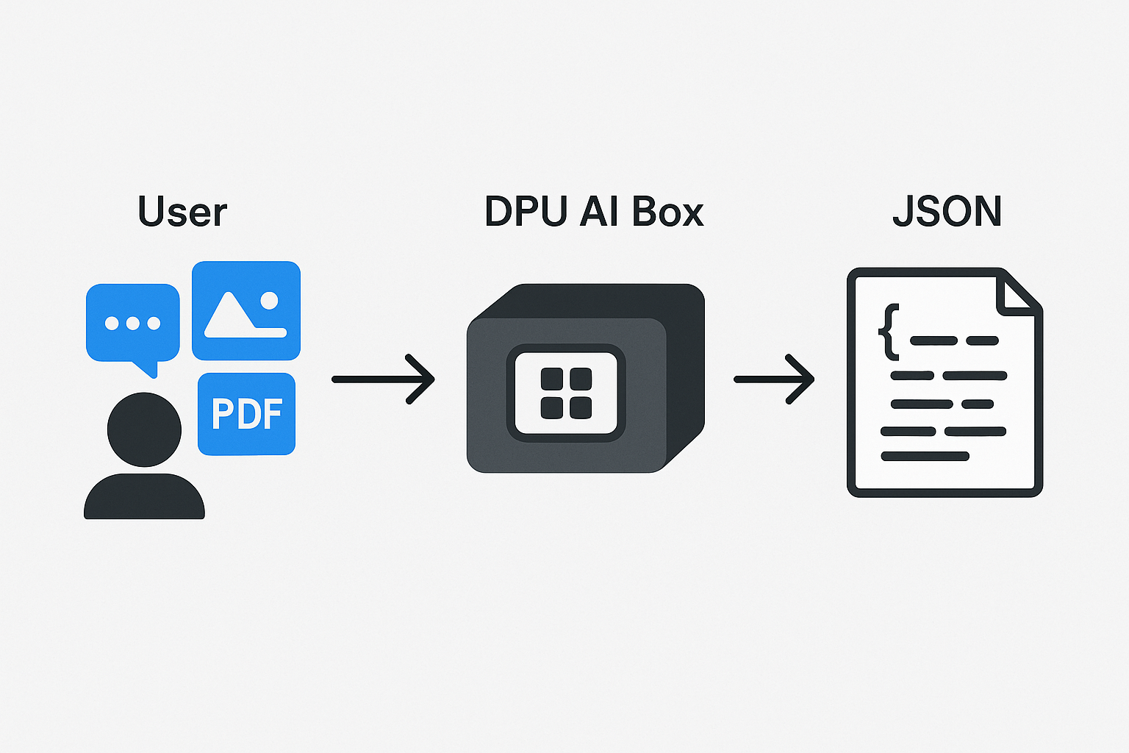
Overview
Development of an AI on Edge solution for processing and extracting content from various user inputs (text, images, PDFs) in JSON format.
Utilizing reinforcement learning based on feedback, and deploying the model on FPGA hardware.
Focus areas of AI processing at the edge using DPU technology and Vision Language Models for effective content extraction.

Slide 5
2. Introduction
The AI Agent Box development will focus on creating a VLM model that can be quantized and deployed onto FPGA – Xilinx KV260 to efficiently process and extract content from text, images, and PDFs.
Key technologies:
DPU for efficient edge AI processing.
Vision Language Models (vLM) for content extraction.
Improve model using Reinforcement Learning methods.

Slide 6
3. Project Process
Phase 1: Research and Development
Phase 2: Implementation and Optimization
Phase 3: Verification and validation

Slide 7
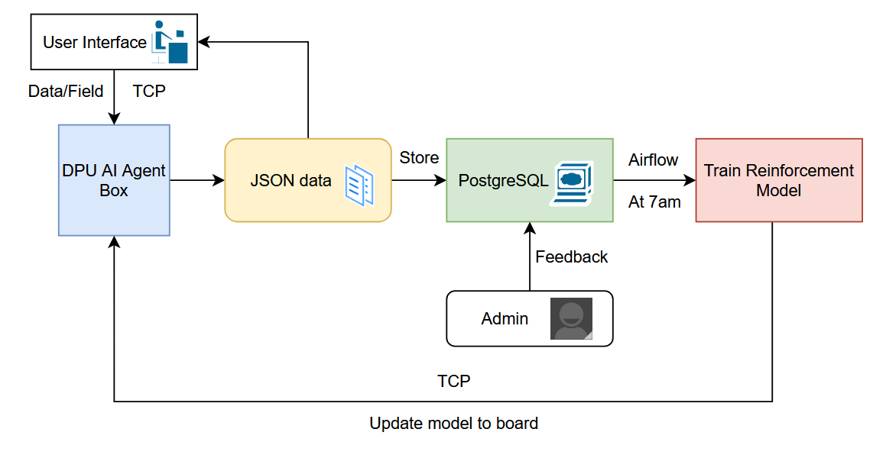
3. Project Process
Phase 1: Research & Development:
Selection of suitable models, frameworks for information extraction across various formats including images, PDFs, and text documents then deploy it on DPU AI Agent Box.
Design an innovative workflow that handles user requests and documents.

Slide 8
3. Project Process
Phase 2: Implementation & Optimization
Implement and evaluate model inference on both CPU and GPU environments.
Develop and integrate a complete reinforcement learning workflow to enhance model performance based on feedback.
Deploy the trained model, and integrate layers of model on a DPU (Deep Learning Processor Unit) for efficient edge inference.

Slide 9
3. Project Process
Phase 3: Verification & Validation
Test and verify the performance of the AI Agent Box on the DPU to ensure reliable and efficient operation.
Validate the efficiency of layer transformations from CPU to DPU, ensuring compatibility and optimal performance across platforms.

Slide 10
4. Protection and Licensing
Once a design is finalized and validated, file for patents to protect the intellectual property.
Develop licensing strategies to market and distribute the DPU – AI Agent Box to interested parties.

Slide 11
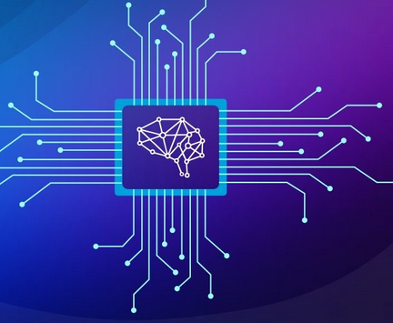
5. Technology and Tools
AI Model/Data Framework: Pytorch, Huggingface, Pandas,...
DPU Deploy Framework: Vitis AI, Vitis HLS,...
AI Box Communication: TCP, PostgreSQL, MongoDB
Automation platform: Apache Airflow, Spark
FPGA with DPU

Slide 12
6. Timeline and develop version
4-6/2025: Market research, requirements gathering, and initial implementation.
7-9/2025: Develop, testing and evaluation version 0.1
10/2025-1/2026: Update to version 0.2
2/2026: IP licensing and documentation
3/2026: Ready to launch Version 1.0
4-12/2026: Launch version 1.0 while develop version 1.1 and 1.2
1/2027: IP licensing and documentation

Slide 13
7. Risk management
Technical Risk: Potential challenges in achieving the desired performance or overcoming design limitations. Mitigation Strategy: Regularly review designs and build prototypes early to minimize unexpected outcomes.
Market Risk: Difficulties in finding licensing partners or customers. Mitigation Strategy: Engage early with industry partners and test different licensing models.
Financial Risk: Budget may exceed expectations due to unforeseen design or prototyping issues. Mitigation Strategy: Monitor project progress regularly and develop contingency plans.

Slide 14
8. Conclusion
Encapsulates cutting-edge AI technologies to create a solution capable of efficiently processing and extracting content from diverse data inputs.
Deliver advanced technologies, including Vision Language Models and FPGA deployment, to address evolving industry demands.
Establish a strong platform for future growth and potential revenue generation.

Slide 15

